Slide 1

Representing Data Graphically
/ STEM Learning Sponsors:

Slide 2
Data
Data is a collection of information and is the most important part of a table or graph.
There are two different types of data.
  Categorical data are data that can be grouped into categories. For example, gender and eye color.
  Numerical data are data that can be measured. For example, weight and height.
/ Representing Data Graphically 2016

Slide 3

Tables
Tables are used to represent data.
Tables make data more organized and easier to interpret than a long list of information.
The information itself is very important, but without organization it can be hard to understand!
/ Representing Data Graphically 2016

Slide 4
Tables
Below are two ways of listing data. Both options represent the exact same data. Which do you think is easier to read?
Option A: During Expedition Gulf of Mexico there were 7 sharks tagged. 2 Sandbar Sharks, 2 Tiger Sharks, 2 Scalloped Hammerhead Sharks, and 1 Bull Shark
Option B:
Expedition | Sandbar | Tiger | Smooth H.H. | Bull | Mako
Gulf of Mexico | 2 | 2 | 2 | 1 | 0
/ Representing Data Graphically 2016
Notes:
Option B is much easier to interpret because the data are organized into a table with a title and headings for each color of Skittle.
4

Slide 5

Tables
OCEARCH, as well as many other scientists, use tables to organize data as it is collected in the field.
A table can easily be converted into a graph, which is a diagram or picture that visually displays the data.
/ Representing Data Graphically 2016

Slide 6


Graphs
Graphs are used to display data in a way that can be easily to interpreted.
There are several different types of graphs including, but not limited to:
  line plots
  bar graphs
  pictographs
  Each type of graph can help to interpret data in different a way.
/ Representing Data Graphically 2016

Slide 7

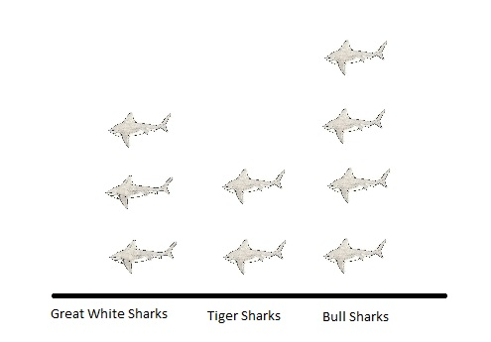
Pictographs
A pictograph is a fun and easy way to display or represent data using pictures.
Below is an example of a pictograph that OCEARCH may use to determine how many sharks they tagged in one week.
Each
represents 1 shark tagged by OCEARCH in 1 week.
/ Representing Data Graphically 2016
Notes:
How many great white sharks were tagged by OCEARCH in 1 week?
Answer: 3
How many tiger sharks were tagged by OCEARCH in 1 week?
Answer: 2
How many bull sharks were tagged by OCEARCH in 1 week?
Answer: 4
7

Slide 8
Line Plots
A line plot shows how often a variable appears in a set of data using a number line.
Line plots are good for visualizing your data.
X
X X X X X X
--------------------------------------------------------------------------------
9 10 11 12 13 14 15 16
Length of Great White Sharks Tagged by OCEARCH (feet)
How many sharks did OCEARCH tag that were 14 feet long?
Notes:
To make a line plot, you need to first decide on the scale of numbers needed for the line by finding the smallest and largest values in your dataset. Then, simply place an “X” above the corresponding number each time that number appears in the data set. For simplicity the numbers in the data set can be rounded to nearest measurement.
8

Slide 9
Bar Graphs
With a bar graph, you can compare variables or track changes over time.
Bar graphs display data using two axes, an x-axis and a y-axis.
y-axis
x-axis
/ Representing Data Graphically 2016
Notes:
9

Slide 10
Bar Graphs
The x-axis is the horizontal scale on the graph.
Independent variables, or variables that are not influenced or changed by other variables, are placed on the x-axis. Examples: time, names of sharks, stage of life, and gender.
The y-axis is the vertical scale on the graph.
Dependent variable, or variables that are influenced or changed by other variables, are placed on the y-axis. Examples: weight, length, or any other number that can change based on the variables.
/ Representing Data Graphically 2016
Notes:
10

Slide 11
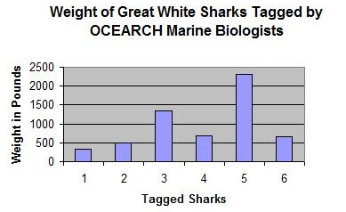
descriptive title
y-axis /dependent variable
x-axis /independent variable
/ Representing Data Graphically 2016
Notes:
How many sharks did OCEARCH tag that weighed 500 pounds?
Answer: 2
How many sharks weighed approximately 2,300 pounds?
Answer: 5
11

Slide 12

Tables and Graphs Review
What type of graph would you use if you wanted to:
  Show how often a variable occurs?
  Line plot
  Compare variables or track large changes over time?
  Bar graph
  Display or represent data using images?
  Pictograph
/ Representing Data Graphically 2016
Notes:
12

Slide 13
Tables and Graphs Review
  What is an example of a numeric variable?
  Weight or length
  What is an example of a categorical variable?
  Stage of life or gender
  What is an independent variable?
  A variable that is not influenced or changed by other variables.
/ Representing Data Graphically 2016
Notes:
13

Slide 14
Tables and Graphs Review
Tables and Graphs Review
  What is a dependent variable?
  A variable that is influenced and changed by other variables.
  Which variable typically goes on the x-axis?
  Independent variable.
  Which variable typically goes on the y-axis?
  Dependent variable.
/ Representing Data Graphically 2016
Notes:
14

Slide 15


Questions?
/ Representing Data Graphically 2016
Notes:
15

