Slide 1

SOLVING WORD PROBLEMS
Grades 3 – 5
/ STEM Learning Sponsors:

Slide 2
SOLVING WORD PROBLEMS
/ BASIC OPERATIONS
/ STEM Learning Sponsors:

Slide 3
/ BASIC OPERATIONS
What are the basic operations?
Addition
Subtraction
Multiplication
Division
/ SOLVING WORD PROBLEMS 2016

Slide 4
/ BASIC OPERATIONS
In school, we often see math problems as a bunch of simple, unrelated equations that are pretty straightforward to solve.
2 + 2 = 4
10 – 1 = 9
2 x 5 = 10
8 ÷ 2 = 4
/ SOLVING WORD PROBLEMS 2016

Slide 5
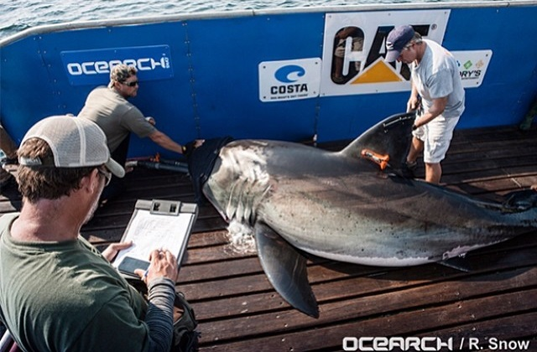
/ BASIC OPERATIONS
In the field, researchers collect so much data they usually encounter complicated problems requiring different combinations of basic operations. These are like complex word problems that can only be solved with strategy and planning ahead.
What strategies can we use to solve word problems?
/ SOLVING WORD PROBLEMS 2016

Slide 6
SOLVING WORD PROBLEMS
/ STRATEGIES FOR SOLVING WORD PROBLEMS
/ STEM Learning Sponsors:

Slide 7
/ STRATEGY: TELLING WORDS
Look for “Telling Words”
Let us know what operations we need to solve the problem.
Addition Add Altogether Both In All Sum Total Together Increased by | Subtraction Take away Difference Fewer How many/much more? Left Less Minus Needs to Remains Subtract | Multiplication Times Every At this rate Of Product Multiplied Doubled, tripled, etc. | Division Each Equal Equally Per Separate Quotient | Solution Is Are Was Were Will be Gives Yields Equals
/ SOLVING WORD PROBLEMS 2016

Slide 8
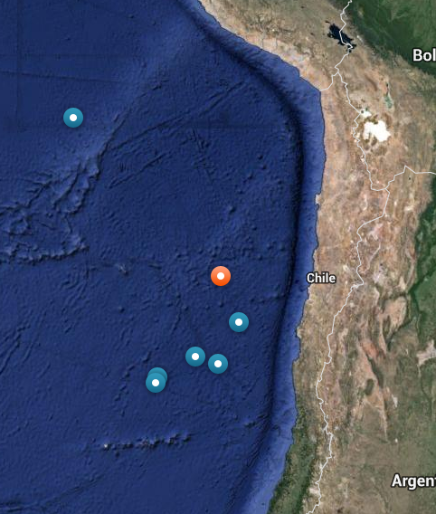
/ STRATEGY: TELLING WORDS EXAMPLE 1A
The OCEARCH Global Shark Tracker™ is a tool for researches to keep track of shark locations. One day, two scientists decided to compare locations from the 7 sharks tagged in Chile and the 4 sharks tagged in Montauk, New York. How many more sharks did they look at from Chile than Montauk?
/ SOLVING WORD PROBLEMS 2016

Slide 9
/ STRATEGY: TELLING WORDS EXAMPLE 1A
“How many more sharks did they look at from Chile than Montauk?”
The telling word here is “how many more”. This tells us to subtract the sharks tagged in Montauk from the sharks tagged in Chile.
7 – 4 = 3
Chile has three more sharks to look at.
/ SOLVING WORD PROBLEMS 2016

Slide 10
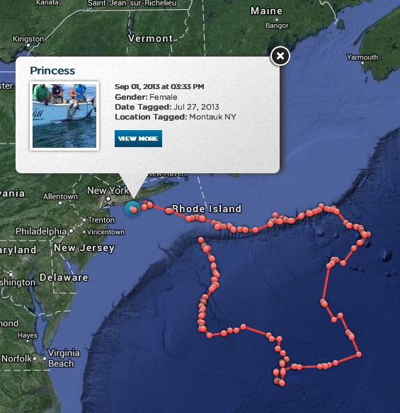
/ STRATEGY: TELLING WORDS EXAMPLE 1B
While gathering data from the 4 sharks tagged in Montauk, the 2 scientists discovered there was so much information they needed to lighten the work load. How many sharks did each scientist gather data from if the work was divided equally?
/ SOLVING WORD PROBLEMS 2016

Slide 11
/ STRATEGY: TELLING WORDS EXAMPLE 1B
“How many sharks did each scientist gather data from if the work was divided equally?”
The key words here is “divide” and “equally”!
4 ÷ 2 = 2
Each scientist gathered data from 2 sharks.
/ SOLVING WORD PROBLEMS 2016
Notes:
Another good division word is “per”. Sharks per scientist means the number of sharks divided by the number of scientists. Our example could also be written as 2 sharks per scientist.

Slide 12
/ STRATEGY: GROUPING SIMILAR ITEMS
Sometimes a word problem can have so many different numbers and words, it becomes difficult keeping the information sorted out.
This is where grouping similar items comes in.
When reading the word problem, look for groups of similar items to help keep things organized.
Let’s take a look at an example…
/ SOLVING WORD PROBLEMS 2016

Slide 13
/ STATEGY: GROUPING SIMILAR ITEMS EXAMPLE 2
Lydia, a white shark, traveled 32 miles (54.5 km) on Sunday, 56 miles (90.1 km) on Monday, 19 miles (30.6 km) on Tuesday, 73 miles (117.5 km) on Wednesday, 67 miles (107.8 km) on Thursday, 37 miles (59.5 km) on Friday, and 23 miles (37.0 km) on Saturday. Beamer the blue shark traveled 22 miles (35.4 km)on Sunday, 3 miles (4.8 km) on Monday, 35 miles (56.3 km) on Tuesday, 29 miles (46.7 km) on Wednesday, 24 miles (38.6 km) on Thursday, 39 miles (62.8 km) on Friday, and 38 miles (61.1 km) on Saturday.
/ SOLVING WORD PROBLEMS 2016
Notes:
How many miles did Lydia travel in a week?
B) How many miles did the sharks travel on Wednesday?
There is a lot of information in this one problem! Luckily for us, the first part of the problem is only concerned with how many miles Lydia traveled. We do not even need to worry about Beamer. So first, let’s group together only the data regarding Lydia…

Slide 14
/ STATEGY: GROUPING SIMILAR ITEMS EXAMPLE 2A
Let’s group all of Lydia’s mileage together:
32 miles (54.5 km) on Sunday
56 miles (90.1 km) on Monday
19 miles (30.6 km) on Tuesday
73 miles (117.5 km) on Wednesday
67 miles (107.8 km) on Thursday
37 miles (59.5 km) on Friday
23 miles (37.0 km) on Saturday
If we add the mileage together we find that Lydia traveled 307 miles (497 km) in a week.
/ SOLVING WORD PROBLEMS 2016
Notes:
The question was, How many miles did Lydia travel in a week? Now that we have grouped similar information together, we can easily solve the problem by adding up Lydia’s mileage.

Slide 15
/ STATEGY: GROUPING SIMILAR ITEMS EXAMPLE 2B
Lydia, a white shark, traveled 32 miles (54.5 km) on Sunday, 56 miles (90.1 km) on Monday, 19 miles (30.6 km) on Tuesday, 73 miles (117.5 km) on Wednesday, 67 miles (107.8 km) on Thursday, 37 miles (59.5 km) on Friday, and 23 miles (37.0 km) on Saturday. Beamer the blue shark traveled 22 miles (35.4 km)on Sunday, 3 miles (4.8 km) on Monday, 35 miles (56.3 km) on Tuesday, 29 miles (46.7 km) on Wednesday, 24 miles (38.6 km) on Thursday, 39 miles (62.8 km) on Friday, and 38 miles (61.1 km) on Saturday.
/ SOLVING WORD PROBLEMS 2016
Notes:
Now, referring back to the original set of information, we can solve the second half of the word problem.
B. How many miles did the sharks travel on Wednesday?
This question is only concerned with how many miles the sharks traveled on Wednesday. Let’s group that information together.

Slide 16
/ STATEGY: GROUPING SIMILAR ITEMS EXAMPLE 2B
Lydia traveled 73 miles (117.5 km) on Wednesday
Beamer traveled 29 miles (46.7 km) on Wednesday
If we add this together we find that the sharks traveled a total of 102 miles (164.2 km) on Wednesday.
/ SOLVING WORD PROBLEMS 2016
Notes:
The question was, How many miles did the sharks travel on Wednesday?
Now that we have grouped similar information together, we can easily solve the problem by adding the miles traveled on Wednesday by both Lydia and Beamer.

Slide 17
/ STRATEGY: THE CUBE METHOD
Use the CUBE Method
Allows us to focus on the important parts of the problem while keeping in mind the question being asked.
C – Circle the numbers
U – Underline important words
B – Box the questions
E – Eliminate unnecessary information
/ SOLVING WORD PROBLEMS 2016

Slide 18
/ STRATEGY: THE CUBE METHOD EXAMPLE 3
Some sharks like to swim close to the ocean surface. When their dorsal fin (top fin) breaks water their satellite tag “pings” in their location. In one month, we tracked four sharks. Maddox pinged in 6 times, Redemption pinged in 11 times, Sofia pinged in 9 times, and Genie pinged in 15 times. How many total times did the four sharks ping in during the month?
/ SOLVING WORD PROBLEMS 2016

Slide 19
/ STRATEGY: THE CUBE METHOD EXAMPLE 3
Some sharks like to swim close to the ocean surface. When their dorsal fin (top fin) breaks water their satellite tag “pings” in their location. In one month, we tracked four sharks. Maddox pinged in 6 times, Redemption pinged in 11 times, Sofia pinged in 9 times, and Genie pinged in 15 times. How many total times did the four sharks ping in during the month?
/ SOLVING WORD PROBLEMS 2016

Slide 20
/ STRATEGY: THE CUBE METHOD EXAMPLE 3
We will need to use addition to solve this problem.
6 + 11 + 9 + 15 = 41
The four sharks pinged in a total of 41 times during the month.
/ SOLVING WORD PROBLEMS 2016

Slide 21
/ STRATEGY: THE CUBE METHOD IN CLASS EXAMPLES
Ms. Miller’s 4th grade class is learning all about sharks through OCEARCH. 5 students are studying about shark physiology, 6 students are studying shark habitats, 3 students are studying sharks in the food web, 7 students are studying shark conservation, 4 students are studying sharks in mythology, and 3 students are studying shark migrations. How many students are in Ms. Miller’s class?
/ SOLVING WORD PROBLEMS 2016

Slide 22
/ STRATEGY: THE CUBE METHOD IN CLASS EXAMPLES
Ms. Miller’s 4th grade class is learning all about sharks through OCEARCH. 5 students are studying about shark physiology, 6 students are studying shark habitats, 3 students are studying sharks in the food web, 7 students are studying shark conservation, 4 students are studying sharks in mythology, and 3 students are studying shark migrations. How many students are in Ms. Miller’s class?
There are 28 students in Ms. Miller’s class.
/ SOLVING WORD PROBLEMS 2016

Slide 23
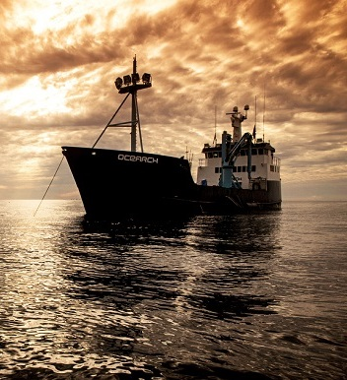
/ STRATEGY: THE CUBE METHOD IN CLASS EXAMPLES
The OCEARCH marine vessel was in the Gulf of Panama on January 1st. It needed to reach Baltra Island in the Galapagos, 950 miles away, 5 days later, on January 6. How many miles per day did the vessel need to travel in order to reach its destination on time?
/ SOLVING WORD PROBLEMS 2016

Slide 24
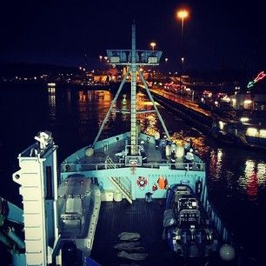
/ STRATEGY: THE CUBE METHOD IN CLASS EXAMPLES
The OCEARCH marine vessel was in the Gulf of Panama on January 1st. It needed to reach Baltra Island in the Galapagos, 950 miles away, 5 days later, on January 6. How many miles per day did the vessel need to travel in order to reach its destination on time?
The OCEARCH vessel needed to travel 190 miles per day to reach their destination on time.
/ SOLVING WORD PROBLEMS 2016

Slide 25
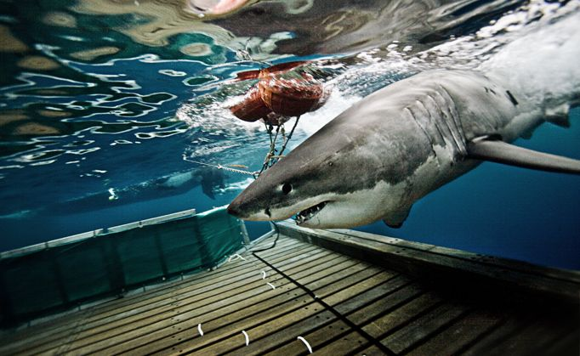
/ QUESTIONS?
/ SOLVING WORD PROBLEMS 2016

