Slide 1

Physics of Shark Movement
Part I - Forces and Energy
/ STEM Learning Sponsors:

Slide 2
Hydrodynamic Adaptations of Sharks
/ STEM Learning Sponsors:

Slide 3
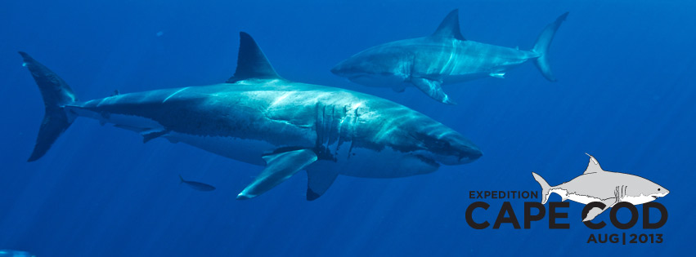

Hydrodynamic Adaptations of Sharks
Great white sharks have a hydrodynamic body shape.
Their torpedo shaped body reduces drag and requires a minimum amount of
energy to swim. Great whites typically cruise at speeds around 2 mph (3.2 kph),
but are built to quickly reach speeds of up to 30 mph (48.3 kph).
/ Physics of Shark Movement Part1 2016

Slide 4

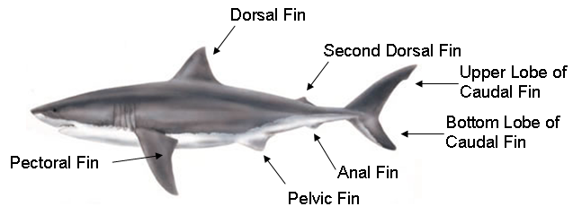


Hydrodynamic Adaptations of Sharks

Slide 5

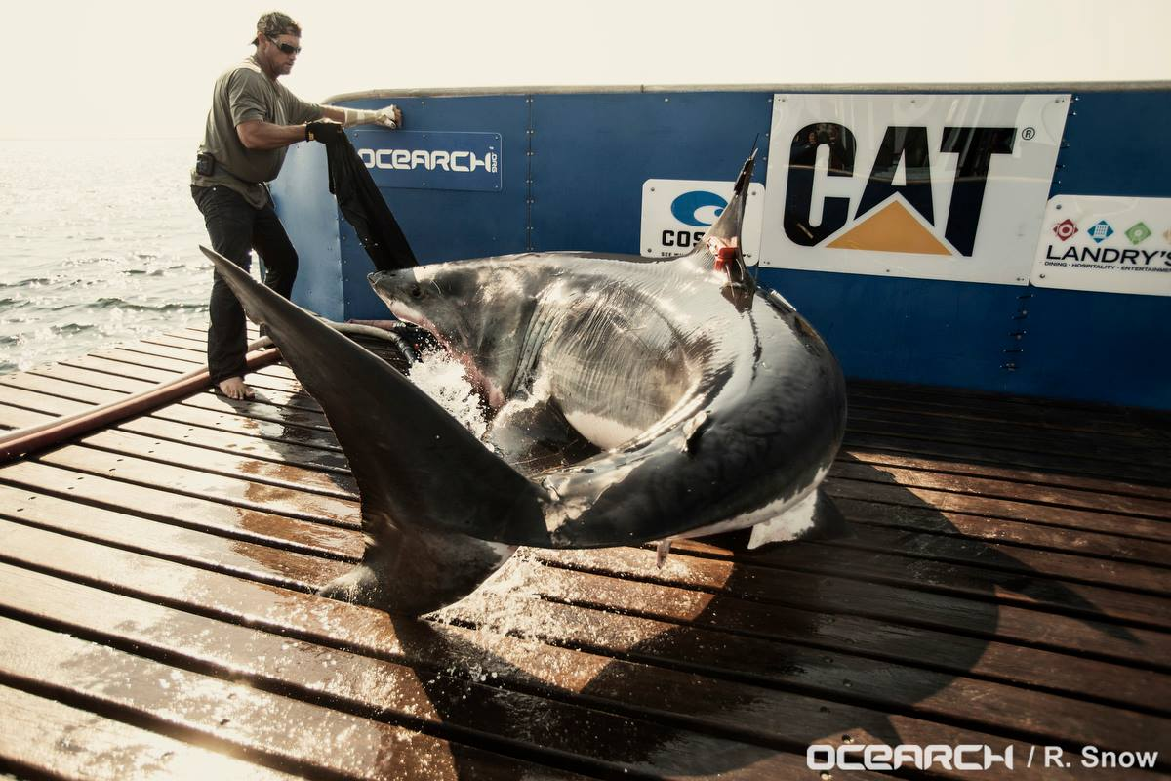
Hydrodynamic Adaptations of Sharks
Caudal Fin – the shark’s tail fin.
Beats side to side to move the shark forward.
Near Homocercal shape – near-symmetrical lobes allow the great white shark to achieve remarkable speeds for hunting, as well as the ability to cruise at slower speeds for long-distance travel while always being energy efficient.

Slide 6

Hydrodynamic Adaptations of Sharks
Dorsal Fin and Pelvic Fins
Used to stabilize the shark’s body as it moves.
Without these fins, the shark would not be able to stay upright and would roll over on its side.
Second Dorsal Fin and Anal Fin
Provides stabilization.
Have a pivoting base which allows the shark to cruise more efficiently at varying speeds.

Slide 7

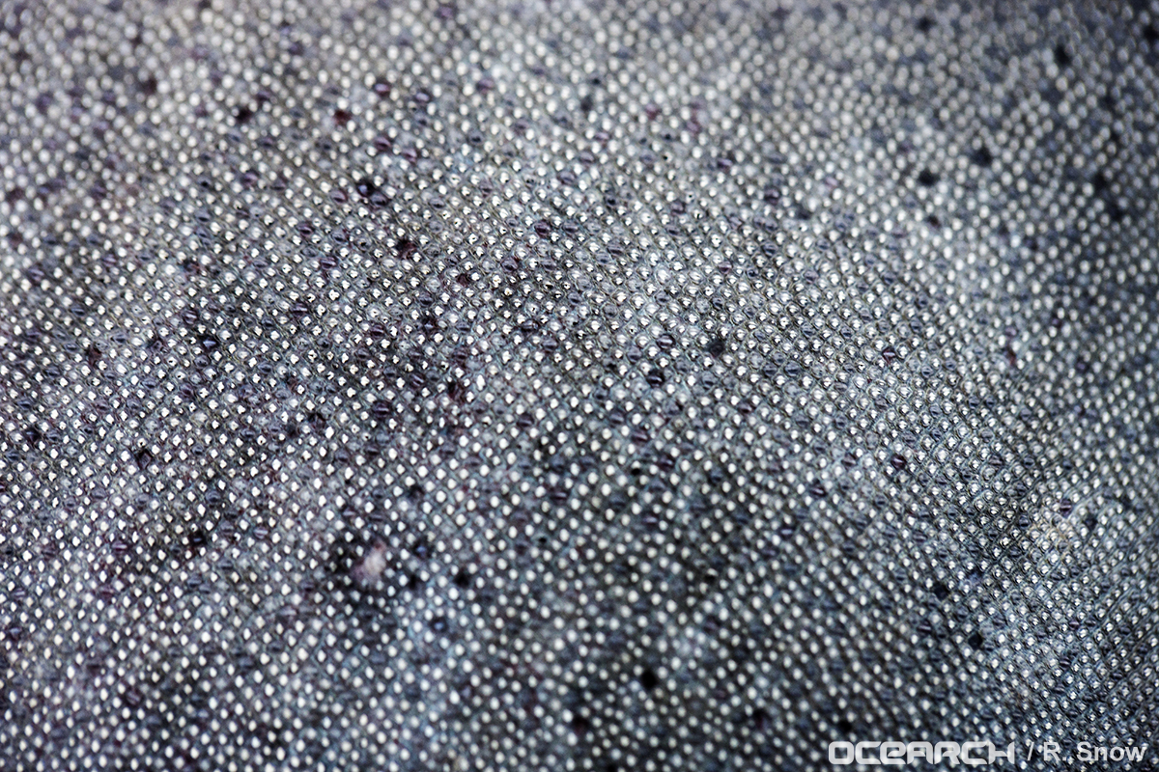
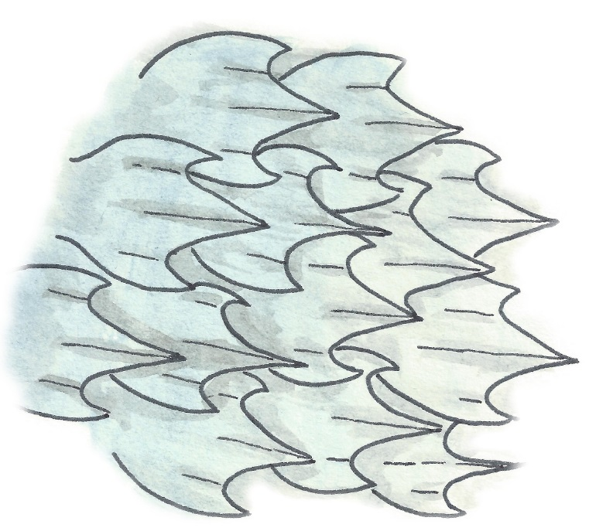
Hydrodynamic Adaptations of Sharks
Dermal Denticles
Modified teeth made from dentine with an
enamel covering. Grow with the sharp pointed
tip facing towards the tail, which is why shark
skin feels so rough. Reduces friction making the
shark more hydrodynamic. Provides a protective
armor for the shark.

Slide 8
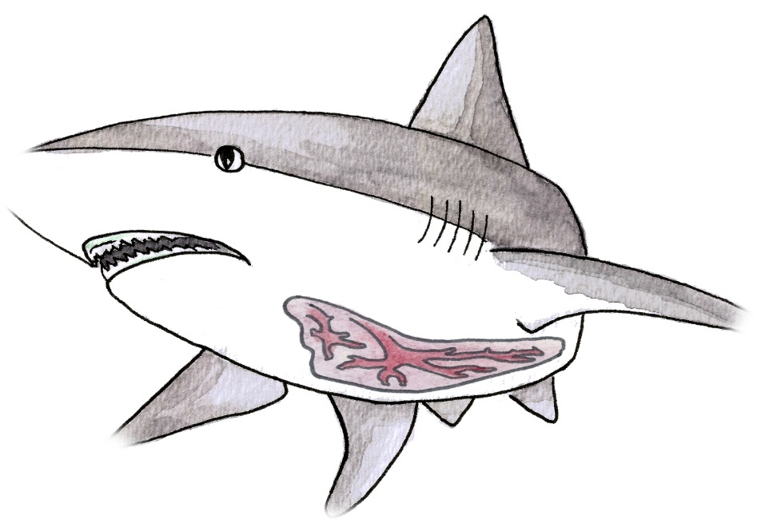
Liver
Sharks have an oily liver.
Provides a little buoyancy which decreases the amount of energy the shark uses to swim.

Slide 9
Forces
/ STEM Learning Sponsors:

Slide 10
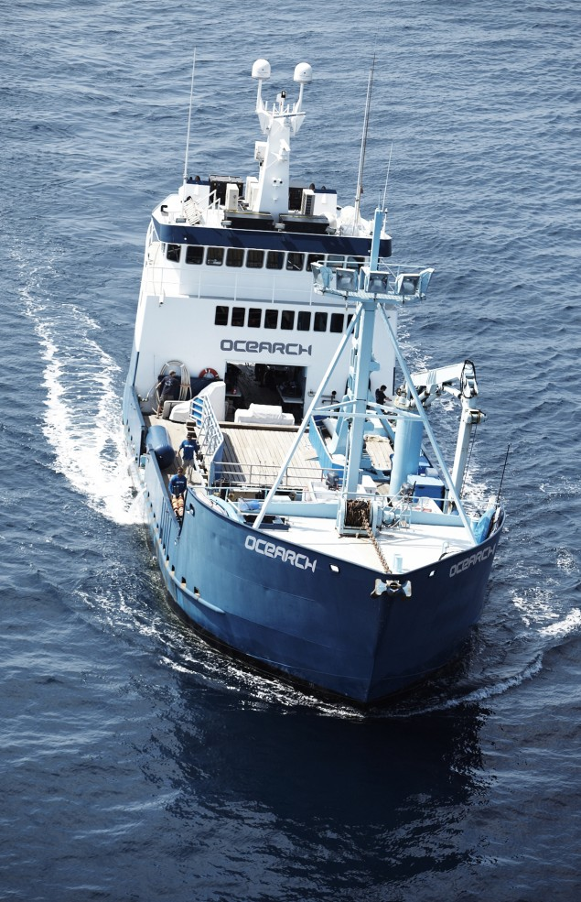
Forces
A force is any influence, such as a push or pull, which causes an object to undergo a change in its state.
Force is a vector quantity that has both direction and magnitude.
Commonly represented by an arrow illustrating the direction the force is acting.

Slide 11

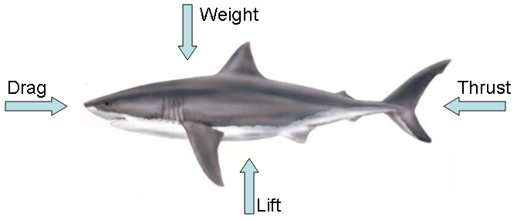
Forces
Swimming is a balance between two sets of forces: thrust and drag, and lift and weight.

Slide 12
Thrust and Drag
/ STEM Learning Sponsors:

Slide 13

Thrust and Drag
Thrust is caused by the side to side movement of the shark’s caudal fin.
  The faster the shark moves its tail, the more thrust it creates allowing the shark to swim faster.
Drag reduces thrust and slows the shark down.
  Drag makes it more difficult for the shark to swim and as a result, the shark must create more thrust to swim successfully.
If drag is greater than thrust, the shark will not be able to swim forward.
What are some examples of drag?

Slide 14

Thrust and Drag
A great white shark is able to increase thrust and reduce drag with several of its adaptations. Do you remember which ones?
Caudal fin
Hydrodynamic torpedo-shaped body
Dermal denticles

Slide 15

Lift and Weight
Lift works opposite of weight. Weight is the result of gravity, which causes the shark to sink.
  If lift is greater than weight, the shark will swim upward.
  If lift is less than weight, the shark will swim downward.
  If the forces of lift and weight are equal, the shark will stay level.

Slide 16

Lift and Weight
When a shark is in motion, its pectoral fins provide lift, which keep the shark level in the water.
Shark fins are an example of a hydrofoil.
  A hydrofoil is any object, design, or adaptation that provides a reaction force when in motion. For example, the hammerhead shark’s flattened head acts as a hydrofoil to provide lift, keeping the shark from sinking due to weight caused by gravity.

Slide 17

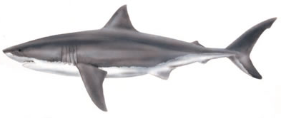

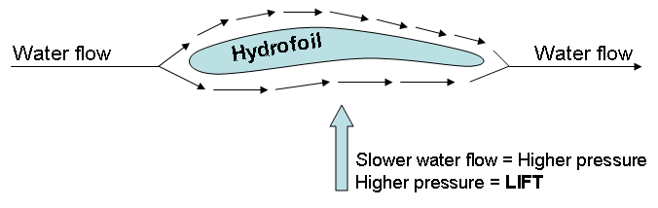
Hydrofoils
As a shark swims, water flows above and below the fins.
The fins are curved so that water flows slower underneath, creating high pressure that pushes the shark upward (lift).

Slide 18
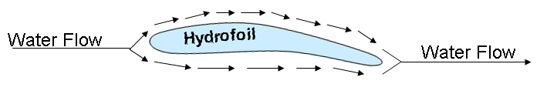
Hydrofoils
Sharks are able to rotate their pectoral fins at slight angles.
  This rotation, no matter how slight, changes the path of water moving around the fins.
What would happen if the shark rotated its pectoral fins up?
fin rotates up
Water above the fin would flow faster than the water below the fin. This creates higher pressure below the fin resulting in lift. The shark will swim upwards.

Slide 19
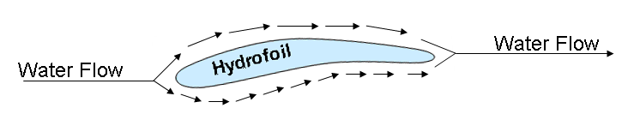
Hydrofoils
What would happen if the shark rotated its pectoral fins down?
fin rotates down
Water below the fin would flow faster than the water above the fin. This creates higher pressure above the fin. The shark would swim downwards.

Slide 20
Potential and Kinetic Energy
/ STEM Learning Sponsors:

Slide 21
Potential Energy
Energy is an object’s capacity for doing work.
  Potential energy is stored energy that is waiting to do work.
    What are some examples of objects with potential energy?
  Kinetic energy is energy in motion that is actually doing work.
    What are some examples of objects with kinetic energy?

Slide 22
Potential Energy
Gravitational potential energy is the energy an object possesses due to its position in a gravitational field, since work is required to elevate objects against Earth’s gravity.
It is dependent on the mass and elevation of the object, since the object has potential to fall back to Earth’s surface.

Slide 23
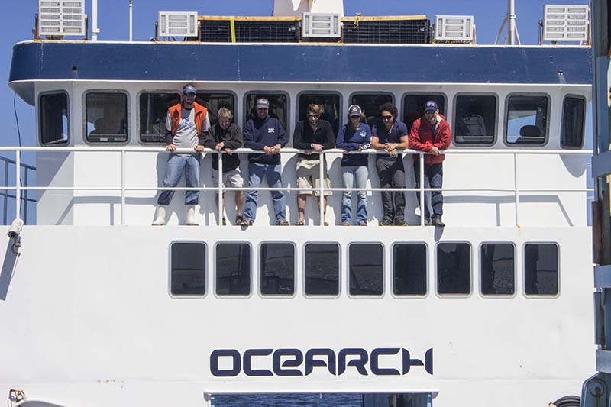
Potential Energy
If two objects with different masses are placed at the same elevation, the object with the greater mass will have more gravitational potential energy.
These six people are standing on the same elevation. The person with the greatest mass has the greatest potential energy.

Slide 24

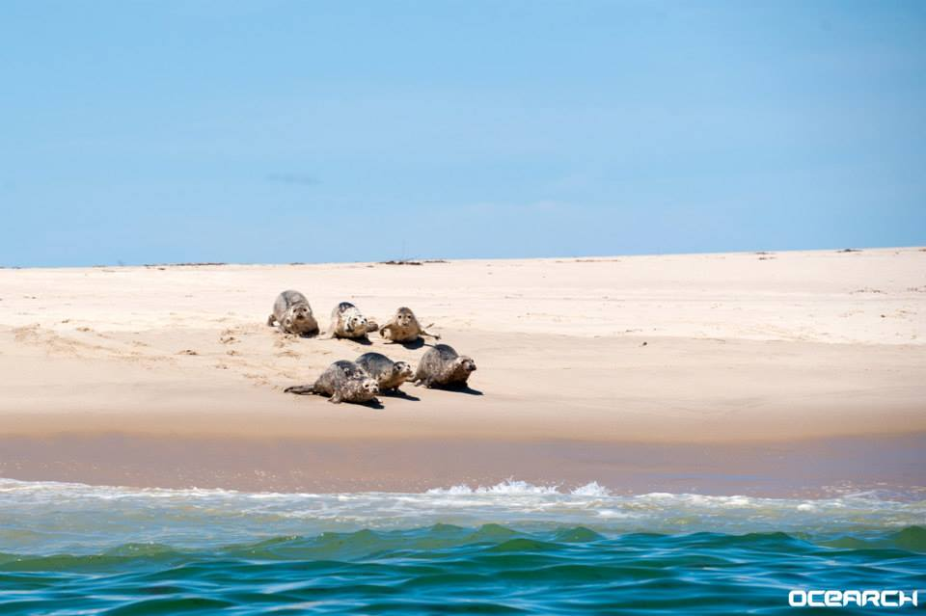
Potential Energy
If two objects with equal masses are placed at different elevations, the object at the higher elevation will have more gravitational potential energy.
If these sea lions all have the same mass, the sea lion at the highest elevation has the greatest potential energy

Slide 25

Potential Energy
The formula to calculate potential energy is:
PE = mgh
PE is potential energy in joules (J)
m is mass in kilograms (kg)
g is gravity (9.8 m/s²)
h is height/elevation of the object in meters (m)

Slide 26

Potential Energy
A joule is a unit of work or energy named after physicist James Prescott Joule.
If we were to keep the original units in the potential energy equation (PE = mgh), they would look like this:
PE = kg x m/s² x m = kg x m²/s²
kg x m²/s² is a intimidating unit to work with so scientists use the unit joule in its place.
1 J = 1 kg x m²/s²

Slide 27

Potential Energy Example
What is the potential energy for a 300 kg sea lion sitting on a rock 2 m above the water?
Step 1: Identify the information.
Formula to calculate potential energy:
PE = mgh
PE = unknown; what we need to solve for
m = 300 kg
g = 9.8 m/s²
h = 2 m

Slide 28
Potential Energy Example
Step 2: Plug the known information into the formula.
PE = 300 kg x 9.8 m/s² x 2 m
Step 3: Solve the equation.
PE = 5,880 Joules (J)
The sea lion has 5,880 Joules of stored energy!

Slide 29
Potential Energy Example
1. Betsy is a 365 kg white shark that was tagged near Cape Cod, Massachusetts. During the tagging process, the hydraulic shark lift was raised 1 m out of the water. What was Betsy’s potential energy while she was being tagged?
2. As the OCEARCH crew was packing for an expedition, someone left a 4.5 kg bag of groceries on the 1.7 m high dock. What was the potential energy of the bag of groceries?
3. One morning, the OCEARCH scientists were so sleepy they forgot to measure a shark’s mass during the tagging process! If the hydraulic lift was raised to a height of 1 m, what would be the shark’s mass in kilograms if its potential energy was 3,000 J? Round to the nearest tenth.
3,577 J
74.97 J
306.1 kg

Slide 30

Kinetic Energy
Kinetic energy is the energy of an object in motion.
It is dependent on mass and acceleration.
  The faster an object is moving, the more kinetic energy it has.
  The more massive an object is, the more kinetic energy it creates.

Slide 31
Kinetic Energy
The formula to calculate kinetic energy is:
KE = (mv²)
2
KE is kinetic energy in joules (J)
m is mass in kilograms (kg)
v is velocity (m/s²)

Slide 32
Kinetic Energy Example
What is the kinetic energy of Mary Lee, a 1,571 kg shark, cruising at 2 m/s?
Step 1: Identify the information.
Formula to calculate kinetic energy:
KE = (mv²)
2
KE = unknown; what we need to solve for
m = 1,571 kg
v = 2 m/s

Slide 33
Kinetic Energy Example
Step 2: Plug the known information into the formula.
KE = (1,571 kg x (2 m/s)²)
2
Step 3: Solve the equation.
KE = (1,571 kg x 4 m²/s² ) Solve the exponent then multiply the numerator.
2
KE = 6,284 kg m²/s² Divide by 2.
2
KE = 3,142 Joules
Mary Lee has 3,142 Joules of energy!

Slide 34
Kinetic Energy Practice Problems
1. If 1039.6 kg white shark Genie cruises at a velocity of 1.6 m/s, what would her kinetic energy be? Round to the nearest tenth.
2. What is the mass of a shark with a kinetic energy of 900.4 J traveling at 2.1 m/s? Round to the nearest tenth.
3. The M\V OCEARCH has a mass of 392,811 kg. If it has a kinetic energy of 2,000,000 J, what is the ships velocity? Round to the nearest tenth.
831.7 J
408.3 kg
3.2 m/s

Slide 35
Converting Potential Energy to Kinetic Energy
A stationary object has the ability to convert its potential energy to kinetic energy as soon as it starts moving.
A 425 kg sea lion is resting on a cliff 5 m above the water. The sea lion decides to go for a swim and jumps off the cliff into the ocean below. A hungry great white shark is swimming nearby and sees the sea lion hit the water. The 967 kg shark increases its velocity to 5 m/s in order to catch the sea lion.
  (a) What is the sea lion’s potential energy?
  (b) What is the velocity of the sea lion just before it hits the water?
  (c) What is the kinetic energy of the shark after it increases velocity to catch the sea lion?

Slide 36
Converting Potential Energy to Kinetic Energy
What is the sea lion’s potential energy?
Step 1: Identify the information.
Formula to calculate potential energy:
PE = mgh
PE = unknown; what we need to solve for
m = 425 kg
g = 9.8 m/s²
h = 5 m

Slide 37
Potential Energy to Kinetic energy Example
Step 2: Plug the known information into the formula.
PE = 425 kg x 9.8 m/s² x 5 m
Step 3: Solve the equation.
PE = 20,825 Joules
The sea lion has 20,825 Joules of stored energy!

Slide 38
Potential Energy to Kinetic Energy Example
What is the velocity of the sea lion just before it hits the water?
Step 1: Identify the information.
In our scenario, the sea lion’s potential energy is being converted to kinetic
energy so we will use the following formula:
PE = KE OR PE = (mv²)
2
PE = 20,825 J
m = 425 kg
v = unknown; what we need to solve for

Slide 39
Potential Energy to Kinetic Energy Example
Step 2: Plug the known information into the formula.
20,825 J = (425 kg x v²)
2
Step 3: Solve the equation.
20,825 J = (425 kg x v²) Multiply both sides by 2.
2
41,650 = 425 kg x v² Divide both sides by 425.
98 = v² Take the square root of both sides.
9.9 m/s = v
The sea lion was moving at a velocity of 9.9m/s!

Slide 40
Potential Energy to Kinetic Energy Example
What is the kinetic energy of the shark when it is going after the sea lion?
Step 1: Identify the information.
Formula for kinetic energy:
KE = (mv²)
2
KE = unknown; what we need to solve for
m = 967 kg
v = 5 m/s

Slide 41
Potential Energy to Kinetic Energy Example
Step 2: Plug the known information into the formula.
KE = (967 kg x (5 m/s)² )
2
Step 3: Solve the equation.
KE = (967 kg x 25 m²/s²) Solve the exponent then multiply the numerator.
2
KE = 24,175 kg m²/s² Divide by 2.
2
KE = 12,087.5 Joules
The shark had 12,087.5 Joules of energy!

Slide 42
Energy Conversion Practice Problems
A 71 kg man is standing on a ship 3 m above the water. The man decides to go for a swim and jumps off the boat into the ocean. A great white shark is swimming nearby and is startled when the man hits the water. The 994 kg shark swims away at a velocity of 4.5 m/s
What is the man’s potential energy when he is standing on the boat?
2. What is the velocity of man just before he hits the water? Round your answer to the nearest tenth.
3. What is the kinetic energy of the shark when it is swimming away? Round your answer to the nearest tenth.
2,087.4 J
7.7 m/s
10,064.3 J

