Slide 1

Physics of Shark Movement
/Real World Applications, Part 3
/ STEM Learning Sponsors:

Slide 2
^{Acceleration}
/ STEM Learning Sponsors:

Slide 3
Acceleration
/ Physics of Shark Movement 2 Real World Applications Part 3 2016
Acceleration
Vector quantity.
Change in an object’s velocity over time.
Change in direction results in acceleration.
Units in m/s²
  Meters per second per second.
  An object’s velocity in meters per second changes every second.
Deceleration
Speed of car decreases.
Average Acceleration
Change in velocity over a length of time.

Slide 4
Acceleration
The formula to calculate average acceleration is:
ā = Δv / Δt
  ā Is average acceleration
  Δv Is the change in velocity
  Δt Is the change in time
/ Physics of Shark Movement 2 Real World Applications Part 3 2016

Slide 5
Acceleration
Another formula to calculate average velocity is:
ā = (v₂-v₁) / (t₂ – t₁)
ā is average acceleration
V₂ is final velocity
V₁ is starting velocity
t₂ is final time
t₁ is starting time
/ Physics of Shark Movement 2 Real World Applications Part 3 2016

Slide 6
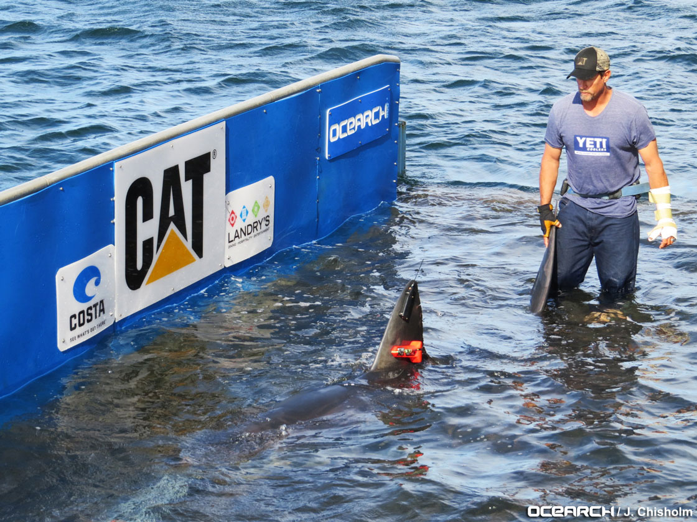
Example 8
A shark sitting in the lift of the M\V OCEARCH is at rest. After being released from the lift the shark begins to swim away. Four seconds later, the
shark’s velocity has
increased to 2 m/s.
What is the shark’s
average acceleration
while swimming away
from the ship?
/ Physics of Shark Movement 2 Real World Applications Part 3 2016

Slide 7
Example 8
/ Physics of Shark Movement 2 Real World Applications Part 3 2016
Step 1. Identify the information:
ā = (v₂-v₁) / (t₂ – t₁)
ā = What we are solving for
v₂ = 2 m/s
v₁ = 0
t₂ = 4 seconds
t₁ = 0

Slide 8
Example 8
Step 2. Plug in the information:
ā = (2 m/s - 0) / (4 seconds – 0 seconds)
Step 3. Solve the equation:
ā = (2 m/s) / (4 seconds)
ā = 0.5 m/s²
The shark was accelerating 0.5 m/s² as it swam away from the ship.
/ Physics of Shark Movement 2 Real World Applications Part 3 2016

Slide 9
Example 9
A great white is cruising leisurely at a velocity of 1.5 mph (2.4 kph). Suddenly, it senses a lone seal straight ahead in the distance. The shark picks up speed and
3.6 s later has caught the seal while having a velocity of 20 mph (32.2 kph).
What is the shark’s average velocity during the hunt?
/ Physics of Shark Movement 2 Real World Applications Part 3 2016

Slide 10
Example 9
/ Physics of Shark Movement 2 Real World Applications Part 3 2016
Step 1. Identify the information:
ā = Δv / Δt
ā = What we are solving for
Δv = 18.5 mph (29.8 kph) (v₂-v₁)
Δt = 3.6 s
The units for acceleration are m/s². Do our units match up? We will need to convert miles to meters and hours to seconds.

Slide 11
Example 9
Miles to Meters
1 mile = 1.6 kilometers
18.5 miles = 29.6 kilometers
1 kilometer = 1,000 meters
29.6 kilometers = 29,600 meters
Δv = 29,600 meters / hour
Hours to Seconds
1 hour = 60 minutes
60 minutes = 3,600 seconds
Δv = 29,600 meters / 3,600 seconds
Δv = 8.22 m/s
/ Physics of Shark Movement 2 Real World Applications Part 3 2016

Slide 12
Example 9
/ Physics of Shark Movement 2 Real World Applications Part 3 2016
Step 2. Plug in the information:
ā = 8.22 m/s / 3.6 seconds
Step 3. Solve the equation:
ā = 2.28 m/s²
The shark accelerated 2.28 m/s² (meters per second per second) to catch the seal!

Slide 13
Practice Problems
/ Physics of Shark Movement 2 Real World Applications Part 3 2016
While the M/V OCEARCH is docked, it is at rest. After starting up the engine the captain begins to navigate towards open water. Ten seconds later, the ship’s velocity has increased to 7 m/s. What is the ship’s average acceleration on its way to open water?
ā = (7 m/s – 0m/s) / (10 s – 0 s)
ā = 0.7 m/s²
The ship had an average acceleration of 0.7 m/s²

Slide 14


Practice Problems
The M\V OCEARCH is cruising leisurely at a velocity of 11 m/s. All of a sudden, the crew gets a call about a great white swimming around six miles ahead. The ship picks up speed and 30 seconds later has increased its velocity of 50 m/s. What is the ships average acceleration during this time?
/ Physics of Shark Movement 2 Real World Applications Part 3 2016
2.
ā = (50 m/s – 11 m/s) / (30 s – 0 s)
ā = 1.3 m/s²
The ship had an average acceleration of 0.7 m/s²

Slide 15
Acceleration
Constant acceleration:
Time (s) | 0 | 1 | 2 | 3 | 4
Velocity (m/s²) | 0 | 2 | 4 | 6 | 8
Non-constant acceleration:
Time (s) | 0 | 1 | 2 | 3 | 4
Velocity (m/s²) | 0 | 3 | 5 | 6 | 8
/ Physics of Shark Movement 2 Real World Applications Part 3 2016
Constant Acceleration
An object’s acceleration changes by the same amount each second.
Instantaneous Acceleration
An object’s acceleration at an exact moment.

Slide 16
Example 10
If a shark has a constant acceleration of 4 m/s², starting from rest, how fast is it traveling after 5 seconds?
The shark was traveling 20 m/s² after 5 seconds.
Time (s) | 0 | 1 | 2 | 3 | 4 | 5
Velocity (m/s²) | 0 | 4 | 4 + 4 8 | 8 + 4 12 | 12 + 4 16 | 16 + 4 20
/ Physics of Shark Movement 2 Real World Applications Part 3 2016

Slide 17
In Class Discussion
Constant acceleration is not the same as constant velocity! An object with a constant velocity is not accelerating!
How can we prove this as a class?
Hint: Refer back to the equation for acceleration.
/ Physics of Shark Movement 2 Real World Applications Part 3 2016

Slide 18
Practice Problems
3 seconds
10 m/s²
1.45 m/s²
/ Physics of Shark Movement 2 Real World Applications Part 3 2016
How long does it take a shark to change its velocity from 10 m/s to 25 m/s if the acceleration is 5 m/s2?
2. If the M\V OCEARCH leaves the dock in Jacksonville, Florida and heads east with a constant acceleration of 0.5 m/s², what is the ships final velocity after 20 seconds? *Hint: Try making a table!
3. A shark is cruising at a velocity of 1.2 mph (1.9 kph). Suddenly, it senses a seal bobbing in the water straight ahead. The shark picks up speed and 2.7 seconds later has caught the seal while having a velocity of 10 mph (16.1 kph). What is the shark’s average velocity during the hunt? *Hint: Pay attention to units!

Slide 19
Accelerometers on Sharks
/ STEM Learning Sponsors:

Slide 20
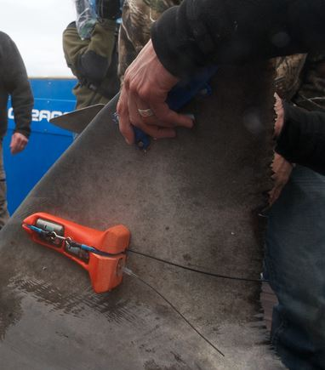
Accelerometers on Sharks
Attaches to a sharks dorsal fin
Tracks shark with GPS
Records acceleration, dive
depths, tail beats, and other
data regarding lifestyle
Provides detailed information
of shark swimming behaviors
by recording body movement
and posture every second
Device eventually detaches
from fin for researchers to
collect and analyze data.
/ Physics of Shark Movement 2 Real World Applications Part 3 2016

Slide 21
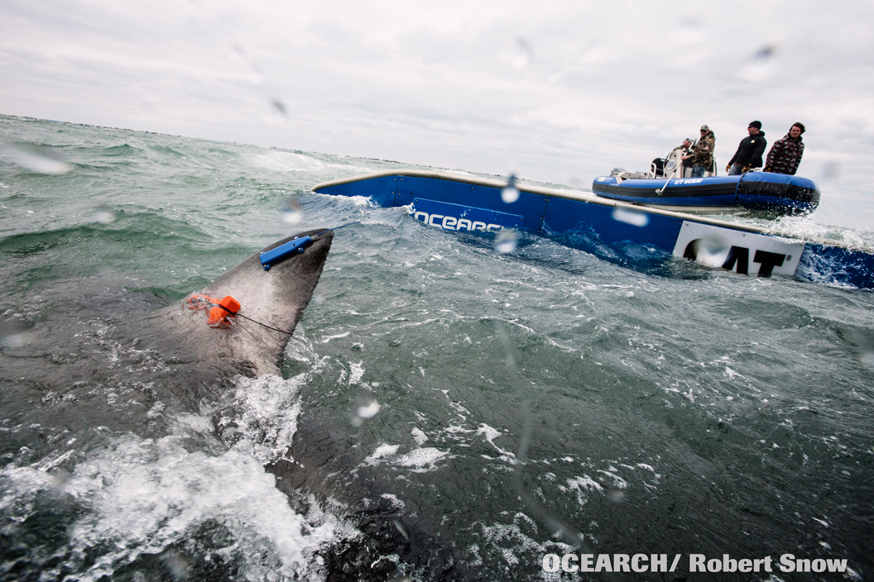
Accelerometers on sharks
Lydia swimming off the lift after tagging. The orange device is the accelerometer, The blue device is the SPOT Tag.
/ Physics of Shark Movement 2 Real World Applications Part 3 2016
Why do researchers need to track sharks after tagging?

Slide 22
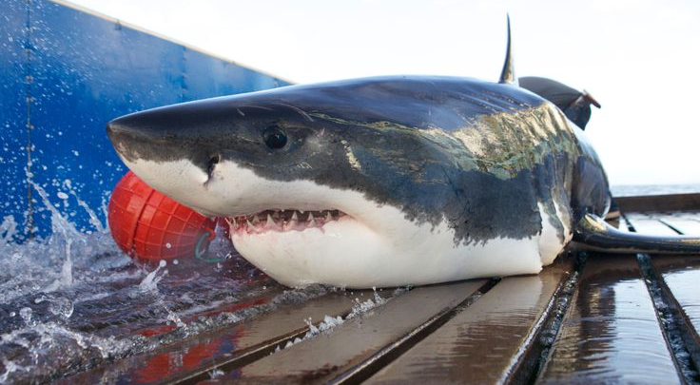
Questions?
/ Physics of Shark Movement 2 Real World Applications Part 3 2016
Notes:
22

