Slide 1

Physics of Shark Movement 2
Real World Applications
Part 2 Speed
/
/ STEM Learning Sponsors:

Slide 2
Speed
Speed is an example of a Scalar quantity.
Refers to the distance that an object moves over a unit of time.
  For example, you could say a car averages 70 mph (112.66 kph) on the highway or an apple falls from a tree at 5 m/s.
/ Physics of Shark Movement 2 Real World Applications Part 2 Speed 2016

Slide 3

Speed
The formula to calculate speed is:
s = d / t
s is speed
d is distance traveled
t is time
/ Physics of Shark Movement 2 Real World Applications Part 2 Speed 2016

Slide 4

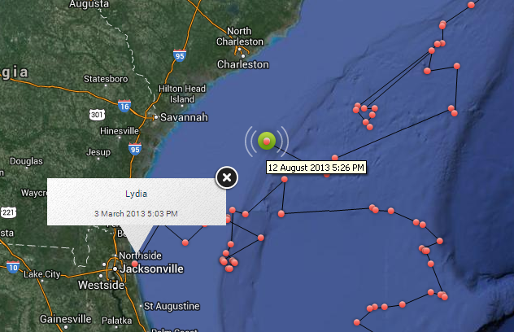
Example 3
Lydia’s first ping after being tagged was on March 3, 2013 at 5:03PM. Her most current ping (as of the time this program was written) was on August 12, 2013 at 5:26 PM. Using the pings to find distance (remember, we do not know the actual path the sharks are swimming underwater!), we are estimating her total migratory route is about 7,000 miles (11,265.41 km).
What was her average speed?

Slide 5
Example 3
Step 1. Identify the information:
Formula: s = d / t
s = What we are solving for
d = 7,000 mi (11,265.41 km)
t = 162 days and 23 min
This number is not practical to work with. To make it a little easier let’s convert time to hours so our units will be in miles per hour.
162 days x 24 hours = 3,888 hours
23 min = x
60 min 1 hour
X = 0.38 hours
t = 3,888.38 hours

Slide 6
Example 3
Step 2. Plug in the information:
s = 7,000 mi / 3,888.38 hrs
Or s = 11,265.41 km / 3,888.38 hrs
Step 3. Solve the equation:
s = 1.80 mph (2.90 kph)
Lydia swam an average of 1.80 mpr (2.90 kph)!

Slide 7
Example 3
This example calculated average speed.
Is it feasible to believe Lydia cruised at 1.80 mph her entire journey?
What are some reasons her speed would have changed?
No
Hunting increases speed, resting lowers speed, etc.

Slide 8
Instantaneous Speed
Speed of an object at an exact moment.
Example:
  The speedometer on a car shows the car’s speed at an exact moment. The instantaneous speed will change as the car slows down and speeds up.

Slide 9
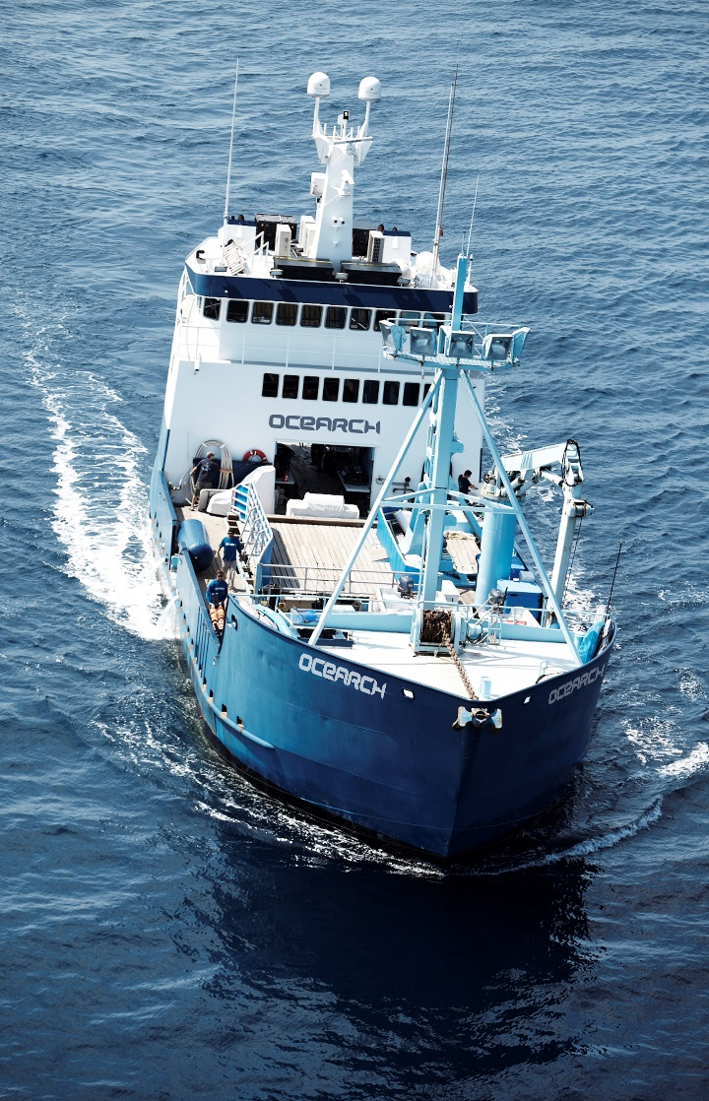
Instantaneous Speed
The M/V OCEARCH is the ship the OCEARCH crew uses on their expeditions. The ship’s top speed is 11 knots (12.65 mph or 20.36 kph).
If the ship is moving at 11 knots (12.65 mph or 20.36 kph), that is its speed at that exact moment, or the instantaneous speed. Just like in our example with the cars, ships also speed up, slow down, and stop during their journey.

Slide 10
In Class Activity
Are the following examples of average speed or instantaneous speed?
A car’s speed over a long distance.
Average Speed
What police radar guns measure.
  Instantaneous Speed
The speed of a shark while hunting.
    Average Speed

Slide 11
In Class Activity
Are the following examples of average speed or instantaneous speed?
A ship traveling at 3.9 knots (4.49 mph or 7.26 kph).
  Instantaneous Speed
The number on a car’s speedometer.
  Instantaneous Speed
The speed at which you ran a marathon.
  Average Speed

Slide 12
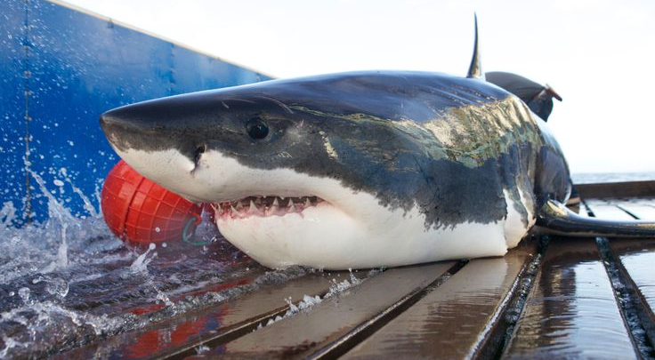

Questions?
Notes:
12

