Slide 1
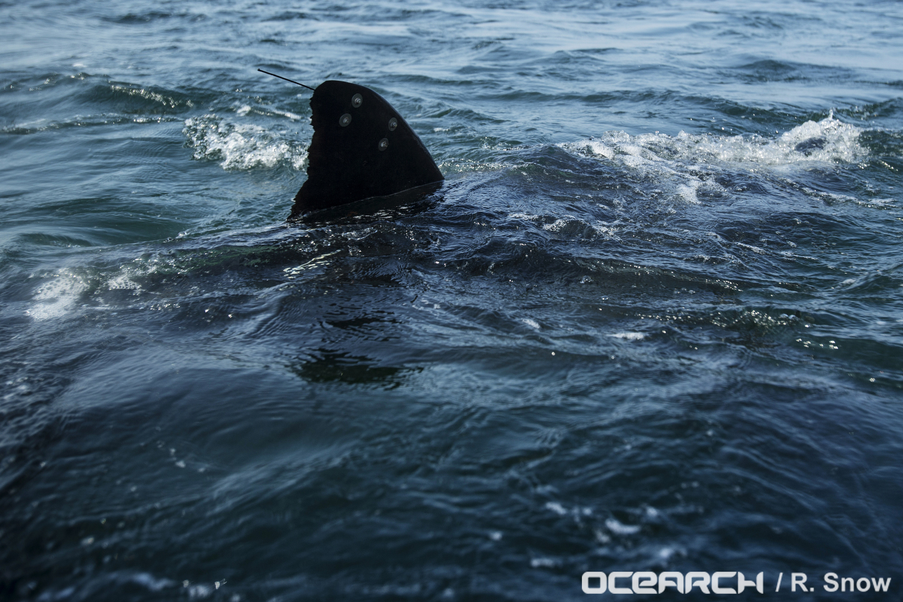

^{Physics of Shark Movement 2}
^{Real World Applications}
/
/ STEM Learning Sponsors:

Slide 2
Scalar vs Vector Quantities
/ STEM Learning Sponsors:

Slide 3

Scalar and Vector Quantities
Scalar Quantities
Measurements with a magnitude.
Tell ‘how much’.
Examples: time, volume, speed, and temperature.
Vector Quantities
Measurements with a magnitude and direction.
Examples: velocity, increases and decreases in temperature.
/Physics of Movement 2 Real World Applications Part 1 2016

Slide 4
Distance verses Displacement
/ STEM Learning Sponsors:

Slide 5
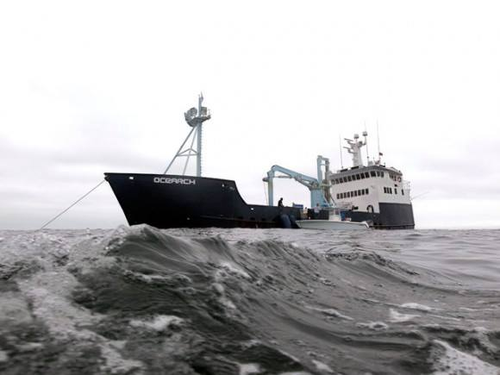

Distance vs. Displacement
Distance
Scalar quantity.
Refers to how much ground an object has covered.
Displacement
Vector quantity.
Refers to an objects overall change in position.
The shortest distance between starting position and final position.

Slide 6
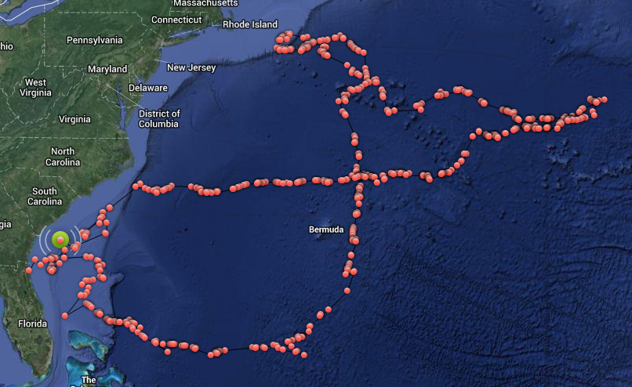
Distance vs. Displacement
Lydia is a female great white tagged off the coast of Jacksonville, Florida. She has traveled a great distance, thousands of miles, since her tagging. Her displacement however, is only about 170 mi (273.59 km), or how far she is from her tagging site.
/Physics of Movement 2 Real World Applications Part 1 2016

Slide 7
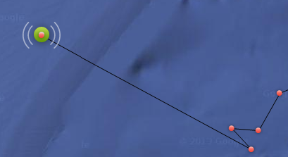
Distance vs. Displacement
The black line connecting the pings shows Lydia’s displacement, or her overall change in position.
/Physics of Movement 2 Real World Applications Part 1 2016

Slide 8
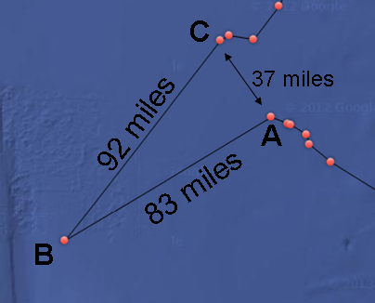
Example 1
What distance did Lydia travel to get from Ping A to Ping C? Let’s imagine Lydia has a great sense of direction and swam in the straight line shown.
Ping A to Ping B = 83 mi (133.58 km)
Ping B to Ping C = 92 mi (148.06 km)
83 miles + 92 miles = 175 mi (281.64 km)
Lydia traveled a total of 175 mi (281.64 km) to get from Ping A to Ping C.
/Physics of Movement 2 Real World Applications Part 1 2016

Slide 9
Example 1
What was her displacement?
What would be Lydia’s
displacement if she went
from Ping A to Ping B, then
back to Ping A?
Displacement is the shortest distance between starting position and final position. In our picture, Lydia’s displacement is shown to be 37 mi (59.55 km).
Her starting position and final position would be the same, so her displacement would be zero.
/Physics of Movement 2 Real World Applications Part 1 2016

Slide 10
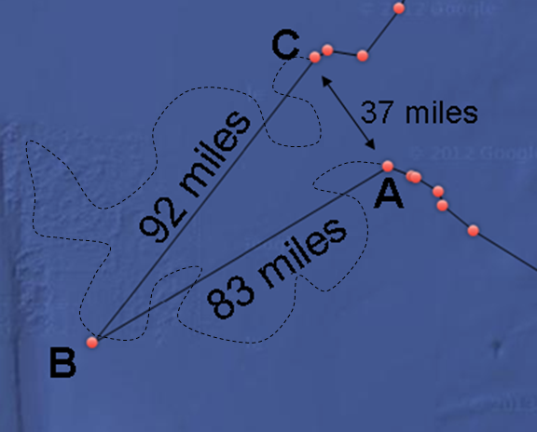
Example 2
Now let’s assume Lydia’s actual swim path is shown as the dotted line.
Does her displacement from Ping A to Ping C change?
No. Her final position has not changed.
If Lydia swam a total of 150 mi (241.40 km) to get to Ping B, what is her displacement?
83 miles (133.58 km)
/Physics of Movement 2 Real World Applications Part 1 2016

Slide 11
Example 2
If the actual distance swam from Ping A to Ping B is 150 mi (241.40 km), and the distance she swam to get from Ping B to Ping C is 208 mi (334.75 km), what distance did Lydia swim to get to Ping C?
Ping A to Ping B = 150 mi (241.40 km)
Ping B to Ping C = 208 mi (334.75 km)
150 mi + 208 mi = 358 mi (576.15 km)
Lydia swam a total of 358 mi (576.15 km) to get from Ping A to Ping C.
/Physics of Movement 2 Real World Applications Part 1 2016

Slide 12
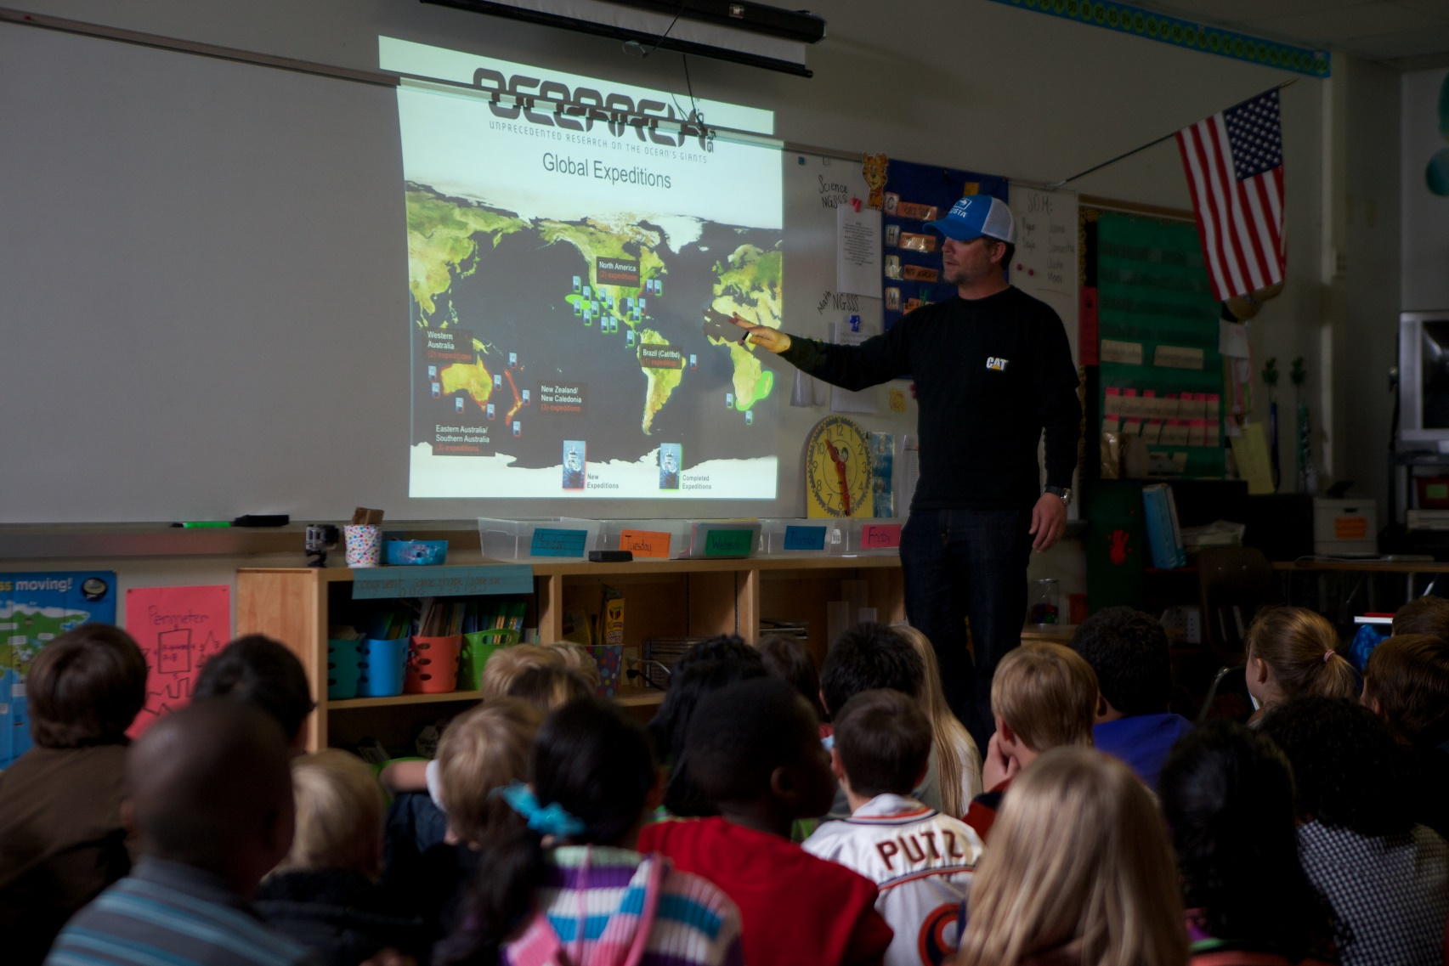
Questions?
Notes:
12

